Slide 1

EEP55C23: Computation for Transportation Engineering
Course Intro
Dr. Andrea Staino
School of Engineering, Trinity College Dublin
Alstom Digital and Integrated Systems
Course Intro
Computation for Transportation Engineering – Hilary Term 2024

Slide 2

Please…
Come to our classes on time (though, better late than skip!)
Mute until you have something to say (but then, ask questions! When you ask questions, we’re so happy!!).
You can use the chat to ask questions, get clarifications, post interesting and funny relevant stuff, ask for a break (but don’t assume we can always see the chat, so please speak up!)
Participate!
Course Intro
Computation for Transportation Engineering – Hilary Term 2024

Slide 3
Today’s plan
Know who we are, and we know something about you;
Know what the course is about and why you would want to be here;
Know the mechanics and the administrivia of the course;
If we have time, start on some technical work….
Course Intro
Computation for Transportation Engineering – Hilary Term 2024

Slide 4
Something about you
Who are you and why are you here today?
Course Intro
Computation for Transportation Engineering – Hilary Term 2024

Slide 5
What this course is about….
We will explore different computational algorithms applied to transportation systems, with a focus on railways.
We will look at the fundamentals of Artificial Intelligence.
We will learn about railway general concepts.
We will deep dive on aspects related to anomaly detection, predictive maintenance, image processing, vehicle modelling, simulation and control, and a variety of other related topics.
We will consider relevant case studies.
Course Intro
Computation for Transportation Engineering – Hilary Term 2024

Slide 6
What this course is not….
A comprehensive course on Computational Methods (EEP55C22)
A course on Transportation Engineering (CE7T01)
A comprehensive course on Machine Learning/CV (EE5C16)
A programming languages course (several, cf. EEP55C22)
….however, we will explore issues related to all of the above!
Course Intro
Computation for Transportation Engineering – Hilary Term 2024

Slide 7
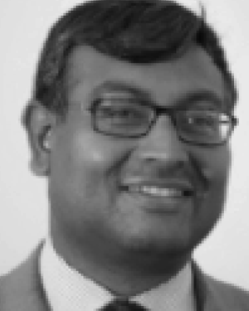
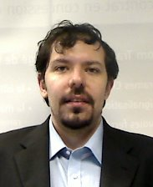
People
Professor Biswajit Basu
Professor (Civil Struct & Env. Eng.)
PhD Indian Institute of Technology, Kanpur, 1998
Time-frequency methods for Structural Systems
MSc Indian Institute of Technology, Kanpur, 1994
PhD in Mathematical Physics University of Vienna, 2019
Research interests: Nonlinear Waves, Hydrodynamics, Mathematical Oceanography, Quantum Computing, Nonlinear Analysis, Wind and Wave Energy, Traffic Flow Theory and Control
Dr. Andrea Staino
Adjunct Assistant Professor (Civil Struct & Env. Eng.)
Senior Expert Data Scientist, Alstom, Paris
PhD, Trinity College Dublin, 2013
Dynamics and Control of Wind Turbines
MSc in Automation Engineering, University of Calabria, 2009
Research interests: Machine Learning for Transportation Systems, Modeling and Simulation, Optimization and Control, Renewable Energy Systems
Course Intro
Computation for Transportation Engineering – Hilary Term 2024

Slide 8
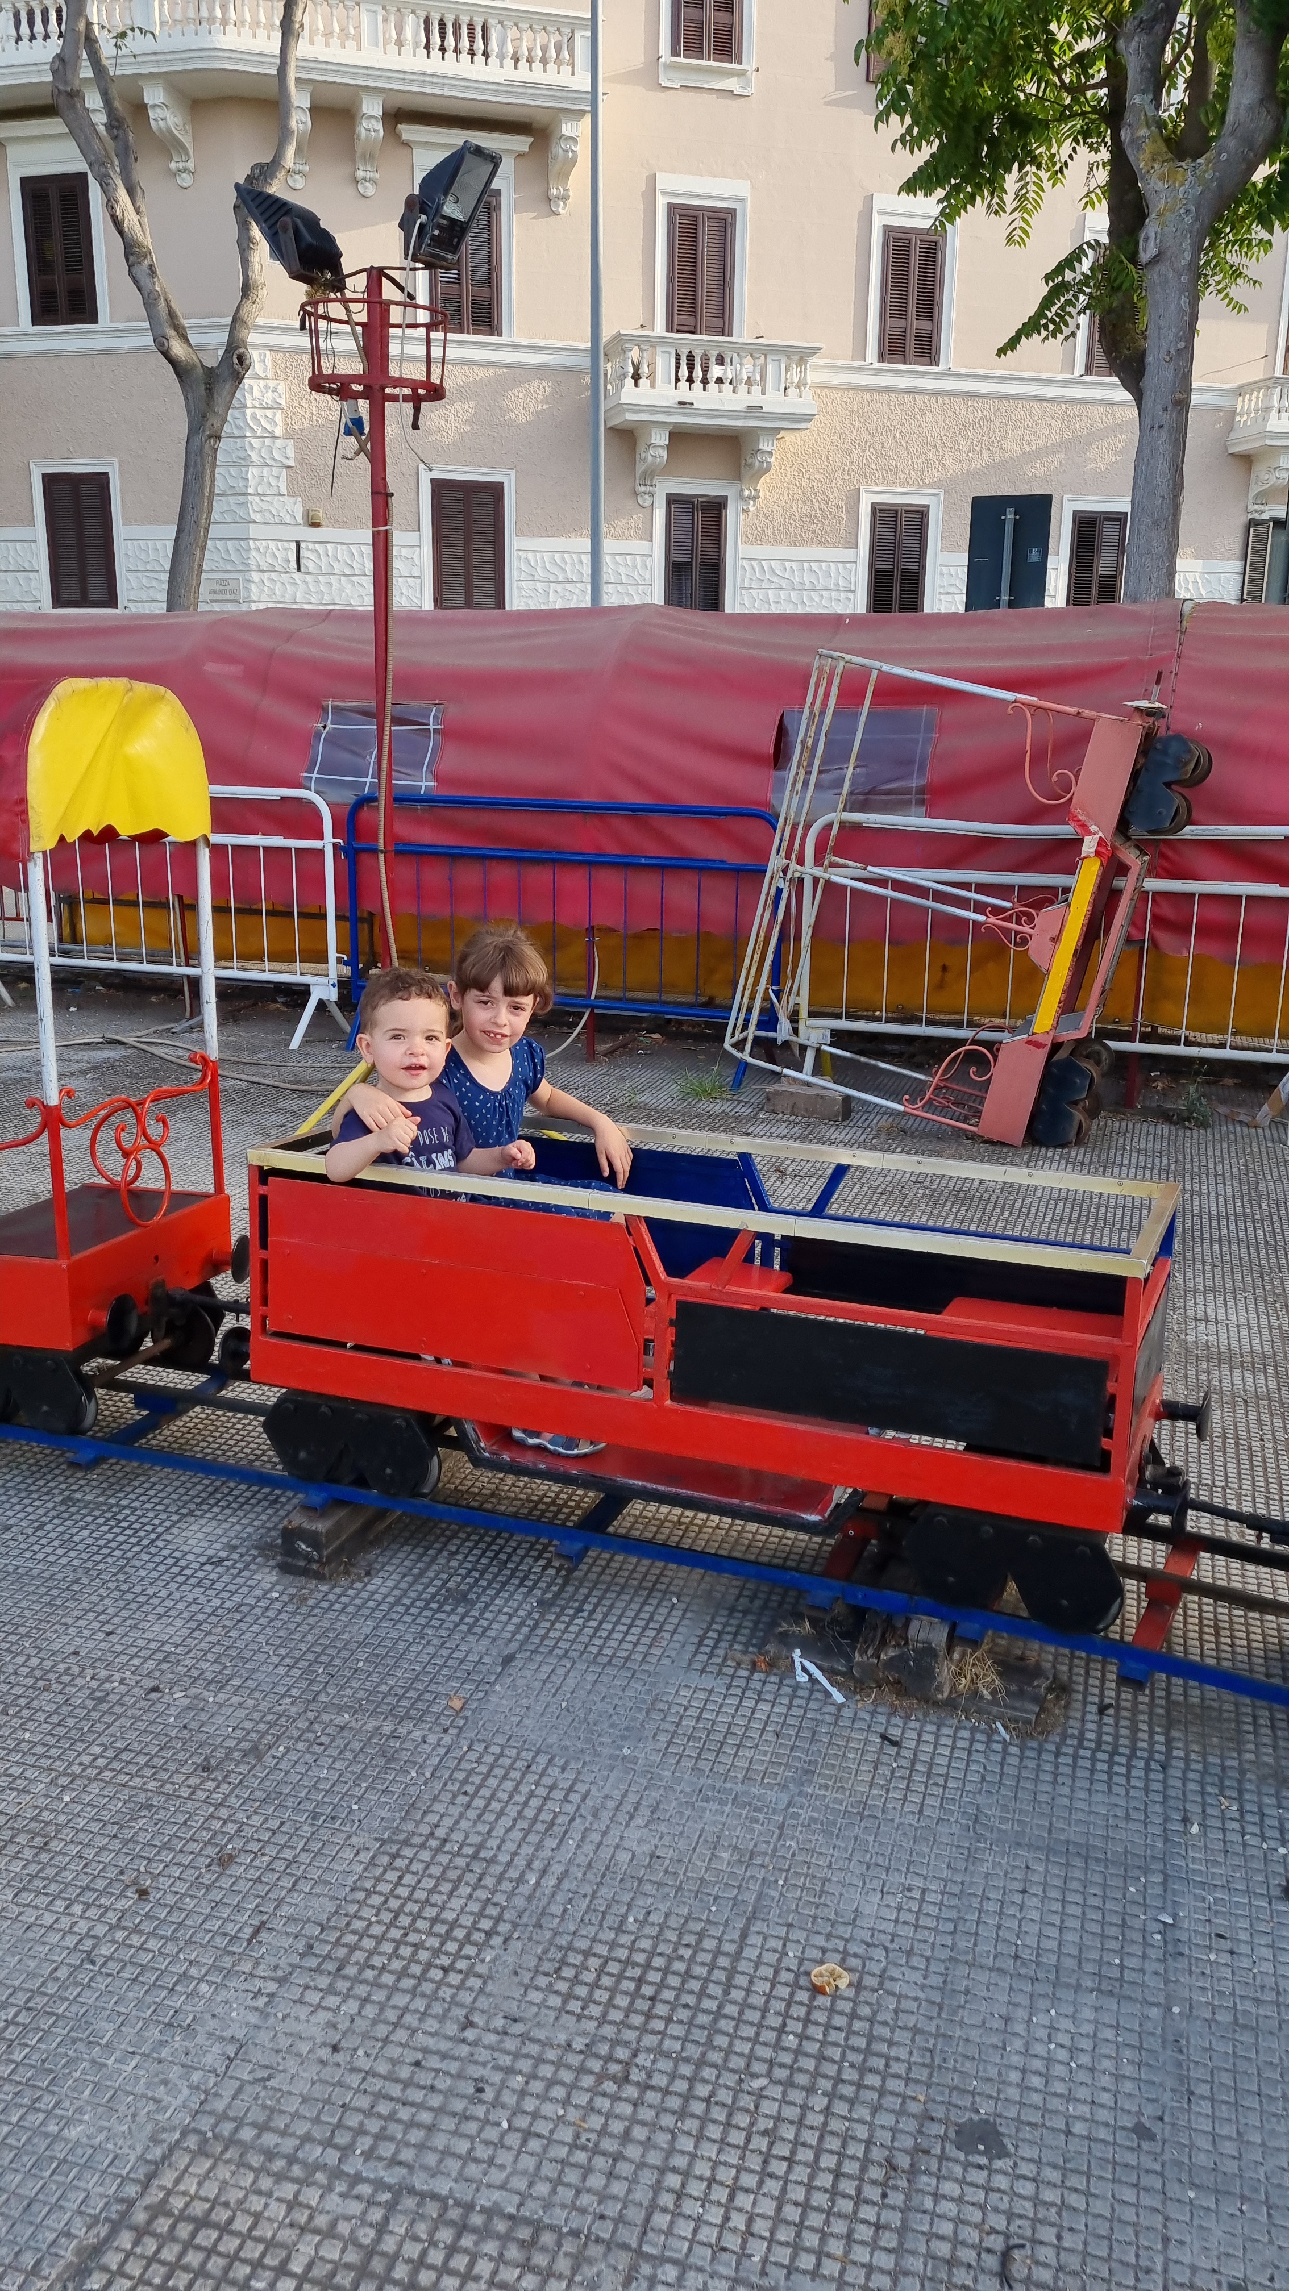
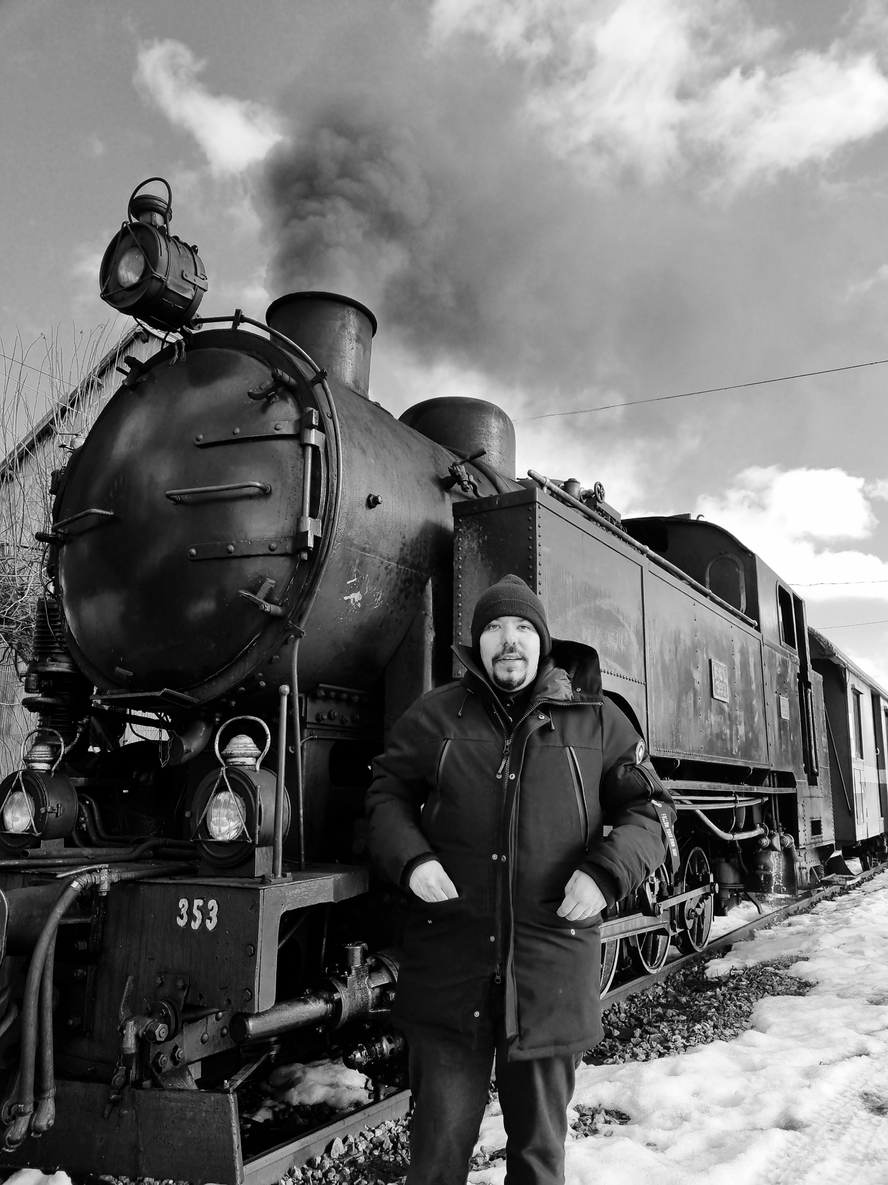
About me
A passion for trains dating back…
What I do at Alstom today (not exhaustive list )…
that continues…
• Project manager for R&D projects: high-speed train (Italy, UK), tramway (France, Spain),
coordination of internal teams and suppliers;
• Product Owner of a railway simulation tool for estimation of energy and operation KPIs;
• Internal trainer for Prognostics and Health Management Alstom course;
• Referent for the Data Science competency skill.
• Application of machine learning techniques for smart troubleshooting on transversal projects.
• Launch initiative for collaborations with Academy and research groups.
Course Intro
Computation for Transportation Engineering – Hilary Term 2024

Slide 9
Class information
Time:
Wednesdays 2-3pm and 4-6pm
Fridays: 9-10am and 2-3 pm
Communications will be sent in case some classes are not taking place
No official textbook, recommended readings provided during the classes
Course website: Blackboard EEP55C23-202324
Slides will be uploaded after each classes (possibly)
Slides represent only a support - to be integrated with coursework, discussion, whiteboard…
Best way to contact us: email basub@tcd.ie, stainoa@tcd.ie, andrea.staino@alstomgroup.com
Part of the lectures will be delivered in-person, part remotely
Guest lectures from Alstom - integral part of the module
Course Intro
Computation for Transportation Engineering – Hilary Term 2024

Slide 10
Prerequisites
Python proficiency
Several libraries
Basic probability and statistics
Distribution, random variable, expectation, variance, sampling
Machine Learning (we will cover the basics, but quickly)
Basics of physics, dynamics, mechanical systems.
Differential Equations
…..mathematics is the key!
Course Intro
Computation for Transportation Engineering – Hilary Term 2024

Slide 11
Course objectives
Be able to:
Select algorithms for decision making issues related to transportation.
Formulate and analyse dynamical models for transportation systems.
List and define problems associated with operation and maintenance of railway systems, and identify potential solutions.
Course Intro
Computation for Transportation Engineering – Hilary Term 2024

Slide 12
Course outline (tentative)
Introduction to AI and ML for railway systems
Promises, Limitations and Challenges
Machine Learning
Tools and methods
Neural Networks
Graphical models
An introduction to Railway Systems
Rolling stock and signalling principles
Notions of railway operation
Workshop on Presentation Mastery for Smart and Sustainable Mobility professionals
Impactful presentation and effective communication skills
Verbal and non-verbal communication improvement
Computational models for mobility
Maintenance applications, Digital twin, Time Series analysis, Traffic Signs recognition
Modeling and Simulation
Monte Carlo methods
Modelica Language
Course Intro
Computation for Transportation Engineering – Hilary Term 2024

Slide 13
Grading
60% Continuous Assessment (CA), 40% Final Exam (FE)
CA:
Coursework (20%): technical assignments (e.g. coding exercises) and readings (e.g. review of papers)
Project (20%): there will be a choice of projects, and you can propose your own.
Workshop (20%): assessment of presentation and communication skills
FE: 4 questions (5 proposed) about the topics covered during the classes
Course Intro
Computation for Transportation Engineering – Hilary Term 2024

Slide 14
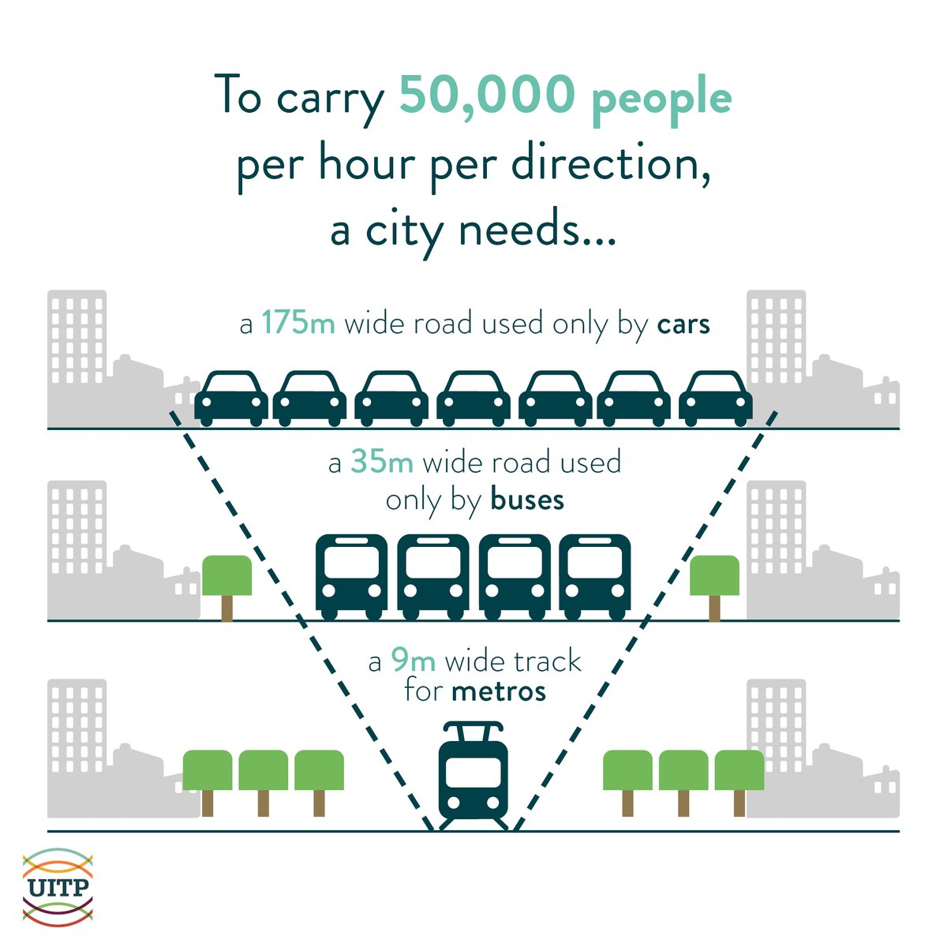
Questions for you
Why do you think an improved transportation system matter?
A. Be on time to classes
B. To favor a sustainable energy transition.
C. Because fares and passes are bloody expensive!
What do you believe is the main challenge for application of Data Science in Railway Systems?
A. Availability of representative data
B. Computational power for processing
C. Lack of competences
What are the main issues transportation systems are expected to face in the coming years?
https://www.uitp.org/
Course Intro
Computation for Transportation Engineering – Hilary Term 2024

Slide 15
Questions?
Course Intro
Computation for Transportation Engineering – Hilary Term 2024

